Slide 1

Internship Program
Hands-on
Applications of AI and Machine Learning in Soil Health: Model Building and Analysis
Presented by
Dr. Prakash M
School of Computer Science and Engineering
Vellore Institute of Technology, Vellore
Date: 06-Jun-2025

Slide 2
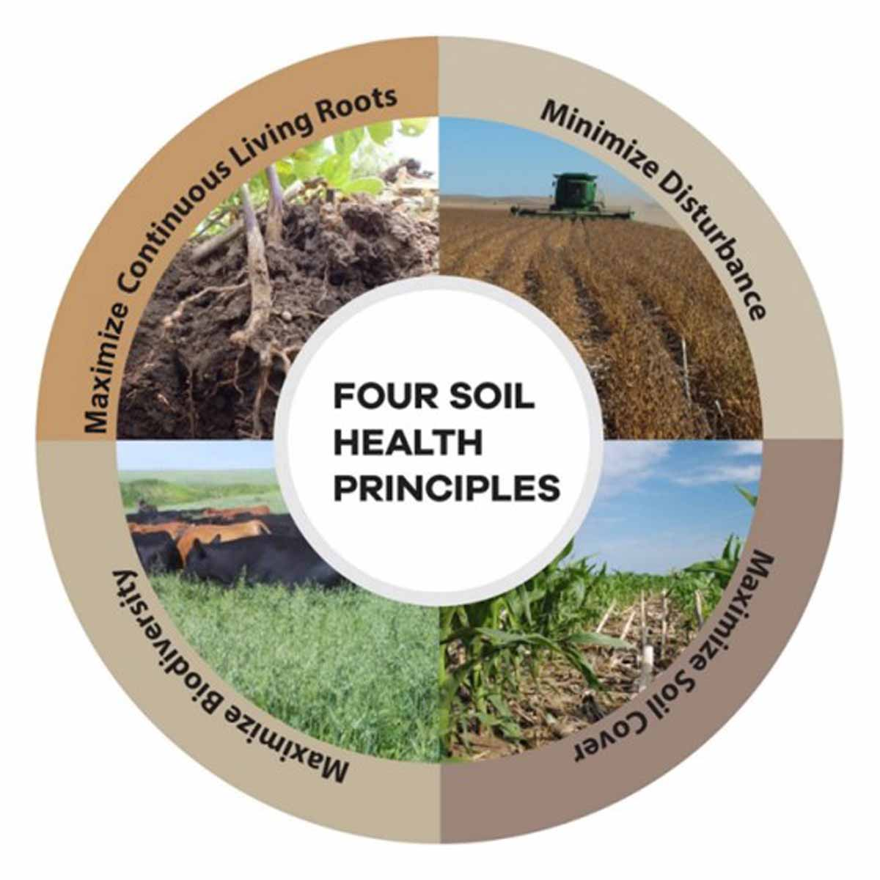
Introduction to Soil Health
Soil health, also known as soil quality, refers to the continued capacity of soil to function as a vital living ecosystem that sustains plants, animals, and humans.
A healthy soil maintains biological productivity, promotes plant and animal health, and supports environmental quality.

Slide 3
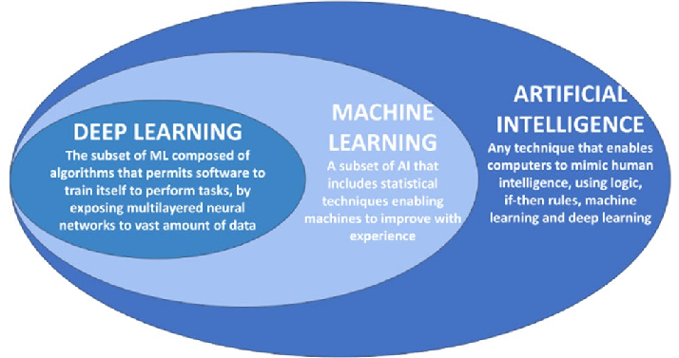
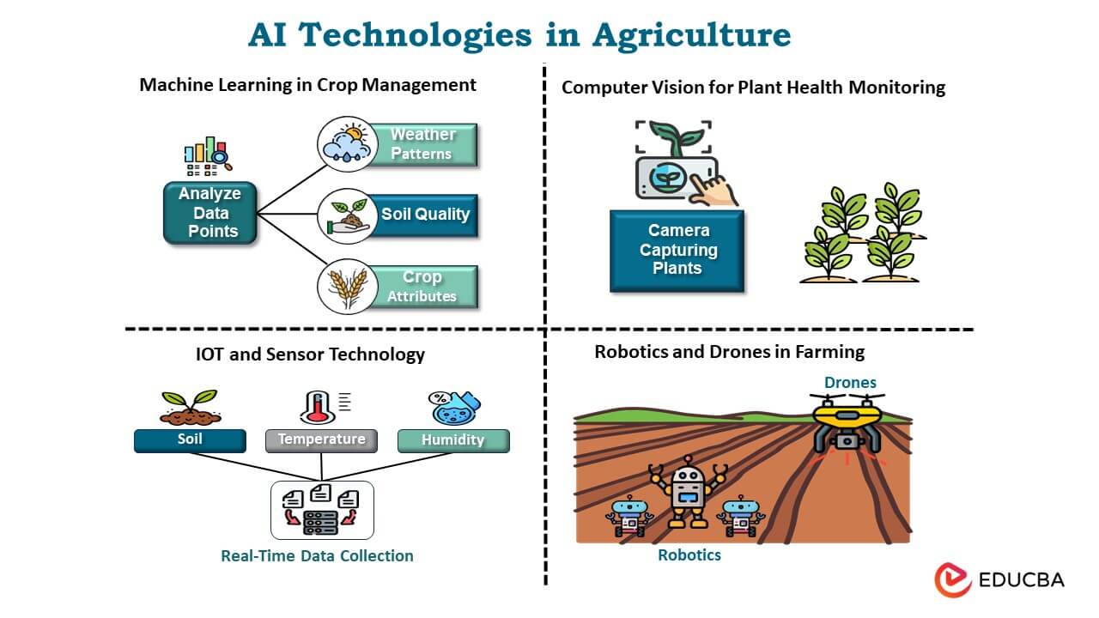
AI and ML in Agriculture
The agricultural sector generates massive amounts of data — from soil properties, crop yields, weather patterns, satellite imagery, to equipment sensors.
Artificial Intelligence (AI) and Machine Learning (ML) help convert this raw data into actionable insights.
They support precision agriculture, enabling more informed decisions, better resource management, and optimized yields.
Source: https://www.educba.com/ai-in-agriculture/

Slide 4
Role of Data-Driven Insights
AI analyzes patterns in complex datasets that humans can’t easily detect.
ML algorithms learn from historical and real-time data to predict
Crop performance
Soil health trends
Nutrient deficiencies
Pest or disease outbreak

Slide 5
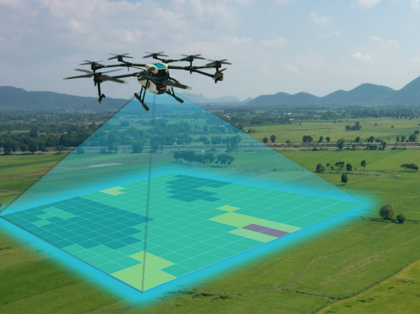
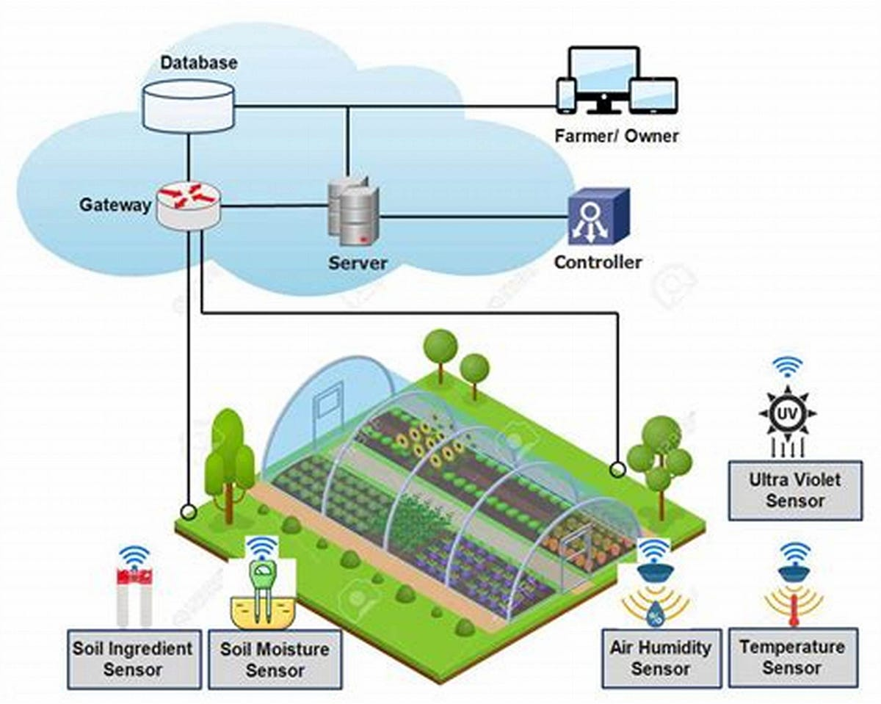
Automation in Monitoring and Decision-Making
Drones + AI = Automated soil imaging and land scanning.
Smart sensors + ML = Real-time soil nutrient and moisture tracking.
AI-powered decision support systems suggest:
When and how much to irrigate
Fertilizer dosage
Best crop choices based on soil and climate
Source: https://techurate.com/soil-analysis-with-drones/
Source: https://binte502.medium.com/smart-sensors-and-iot-real-time-soil-and-crop-monitoring-96d6d50176c6

Slide 6
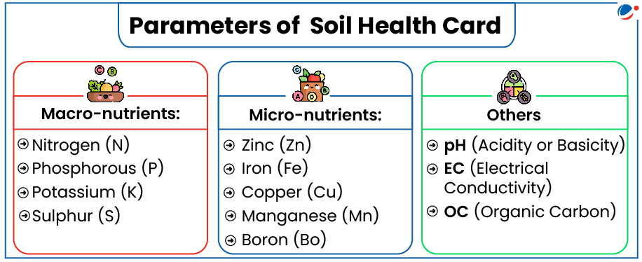
Source: https://visionias.in/current-affairs/monthly-magazine/2025-03-24/environment/soil-health-card-scheme

Slide 7
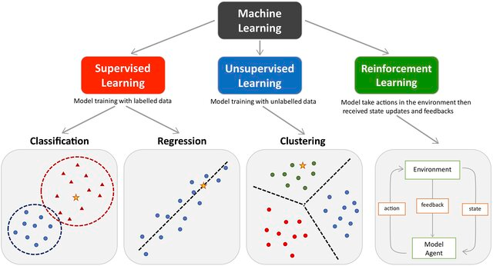
Types of Machine Learning
soil classification and
clustering.
crop recommendation,
disease detection
autonomous farming systems

Slide 8
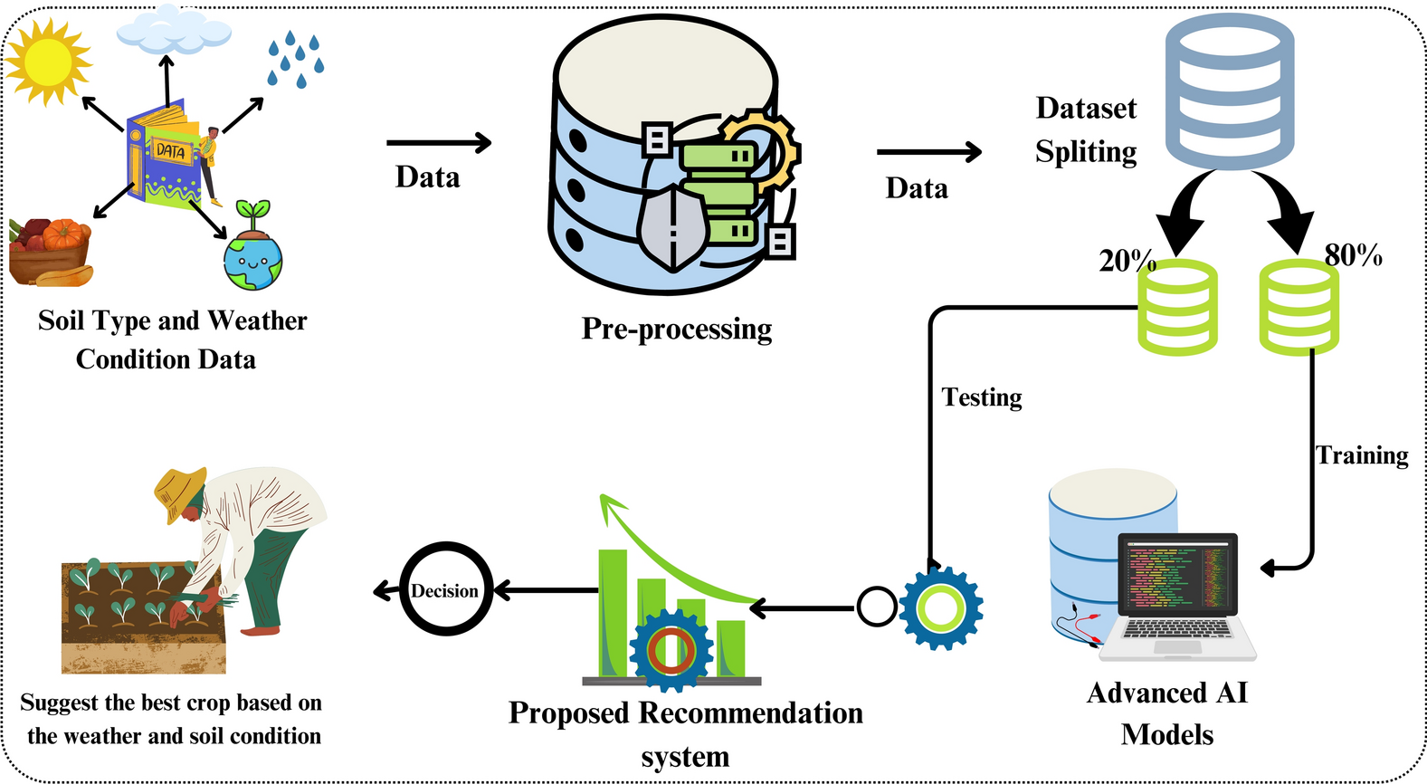
Supervised Machine Learning Algorithm
Source: https://www.nature.com/articles/s41598-025-88676-z

Slide 9
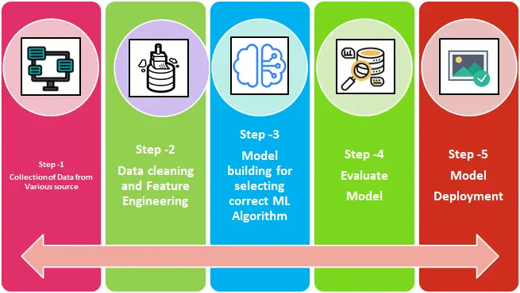
Steps involved in Machine Learning

Slide 10
Step1: Databases and Resources
Indian Government Open Data Portals (https://soilhealth.dac.gov.in/)
FAO (Food and Agriculture Organization of the UN) (http://www.fao.org/soils-portal)
Kaggle Datasets (https://www.kaggle.com/datasets/atharvaingle/crop-recommendation-dataset)
ISRIC – World Soil Information (https://www.isric.org/explore/soilgrids)
Agricultural Research Institutions
ICAR (Indian Council of Agricultural Research) - https://icar.org.in
USDA NRCS Soil Data Mart (USA) - https://sdmdataaccess.sc.egov.usda.gov/

Slide 11
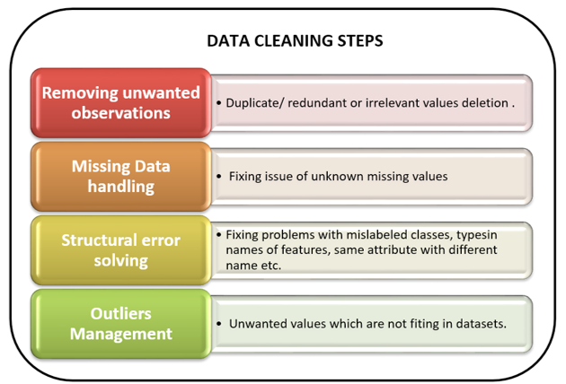
Step2: Data Cleaning

Slide 12
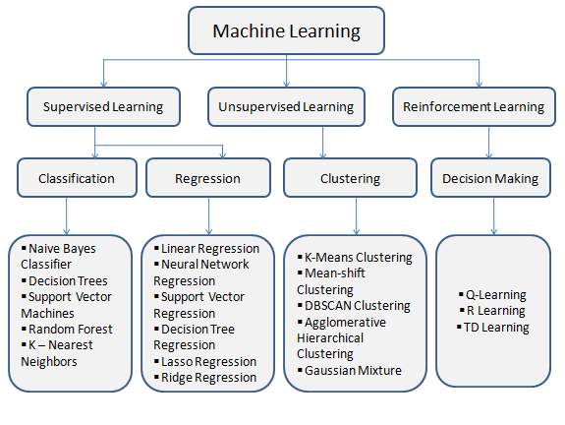
Step3: Machine Learning algorithms

Slide 13
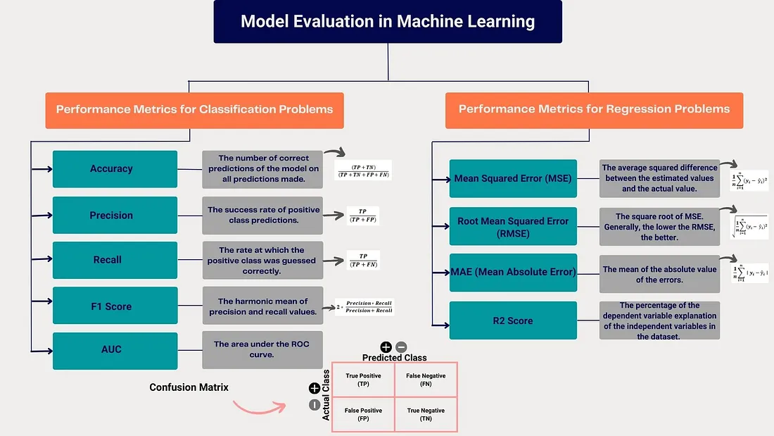
Step4: Model Evaluation
Source: https://medium.com/@neslihannavsar/model-evaluation-metrics-in-machine-learning-classification-and-regression-analysis-aedf99d4fa8a

Slide 14
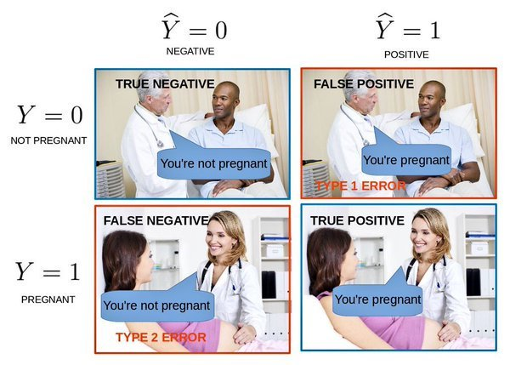
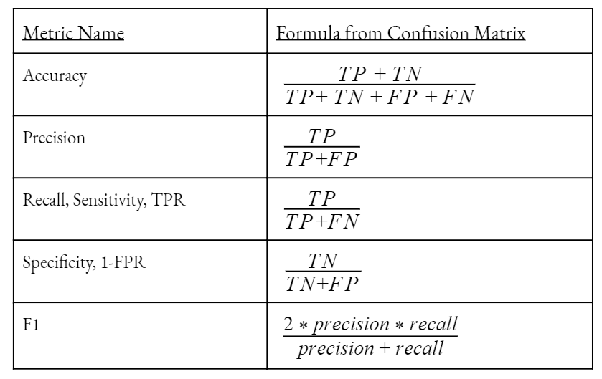
Confusion Matrix
Source: https://medium.com/@neslihannavsar/model-evaluation-metrics-in-machine-learning-classification-and-regression-analysis-aedf99d4fa8a

Slide 15
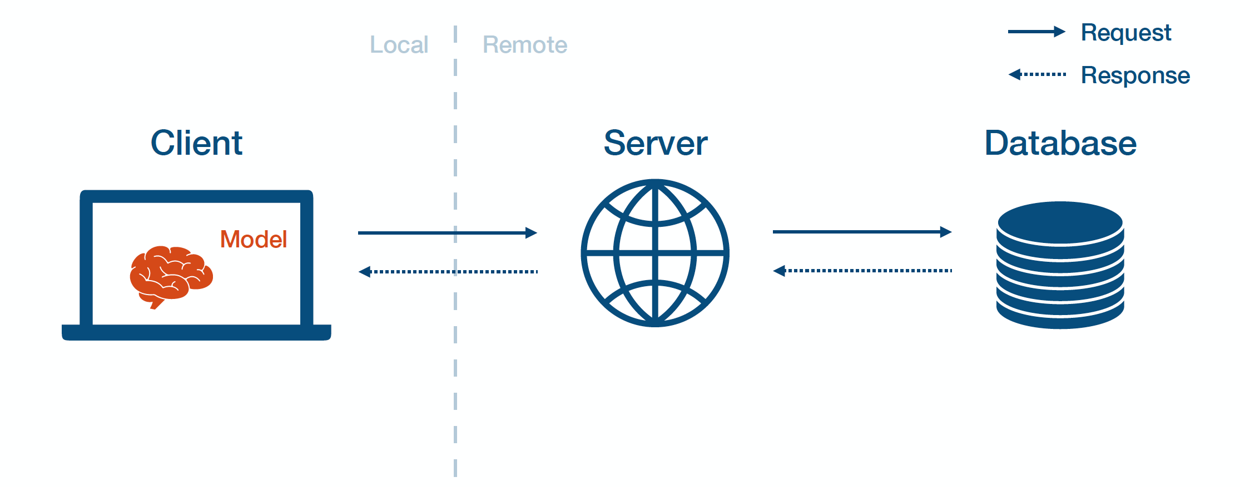
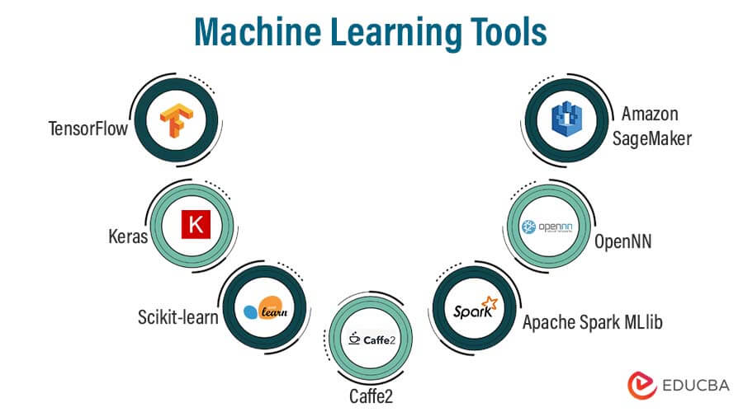
Step5: Model Deployment
Source: https://www.educba.com/machine-learning-tools/

Slide 16
Role of Machine Learning in Agriculture
Crop and Soil Health Monitoring
Weather Prediction and Climate Analysis
Yield Prediction
Soil Classification and Fertility Assessment
Precision Agriculture
Crop Recommendation Systems
Irrigation and Water Management
Pest and Disease Prediction
Supply Chain Optimization

Slide 17
Case Study - Crop Yield Prediction Using Machine Learning Models
To develop and compare the performance of various machine learning models in predicting rice yield based on agro-climatic and soil parameters in a region of India.

Slide 18
Research Application on Agriculture
Soil Quality Assessment & Classification
Crop Recommendation Systems
Irrigation Prediction and Water Management
Soil Erosion Risk Mapping
Soil Organic Carbon and Fertility Prediction
Soil pH & Nutrient Level Estimation from Remote Sensing
Weed and Pest Detection Using AI
Deep Learning for Soil pH Prediction from Drone Imagery

Slide 19
Future Directions
AI-Powered Precision Agriculture - decision-making using edge AI and sensor fusion
Integration with Satellite and Drone Imager
Farmer-Centric Mobile Applications - Voice-enabled apps using NLP
Soil Health Monitoring via IoT and AI - data streaming into ML dashboards
AI for Sustainable and Climate-Resilient Farming
Explainable AI in Agriculture
Genomics + AI for Crop Breeding
Blockchain + AI for Soil-to-Shelf Traceability
AI-Driven Policy and Decision Support

Slide 20
Learning Resources
AI for Agriculture [edX / FutureLearn / FAO e-learning Academy]
Machine Learning for Soil and Crop Prediction – [Coursera, Udemy]
Earth Data Analytics Using Machine Learning – [Earth Lab, University of Colorado Boulder]
Artificial Intelligence in Agriculture by Rajeev Pratap Singh
Data Science in Agriculture and Natural Resource Management by Himanshu Pathak

Slide 21
Demo
https://github.com/salemprakash/VAIAL-Handson

Slide 22


